Slide 1

Control structures

Slide 2
Conditional statements

Slide 3
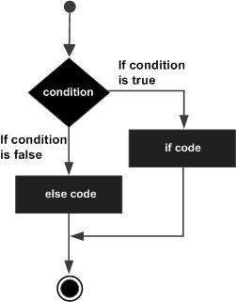
IF Statement
if condition_1:
statement_block_1
else:
statement_block_2

Slide 4
Elif statement
The elif statement allows you to check multiple expressions for TRUE and execute a block of code as soon as one of the conditions evaluates to TRUE.
if condition_1:
statement_block_1
elif condition_2:
statement_block_2
else:
statement_block_3

Slide 5
Loops
giridher.sadineni@gmail.com

Slide 6
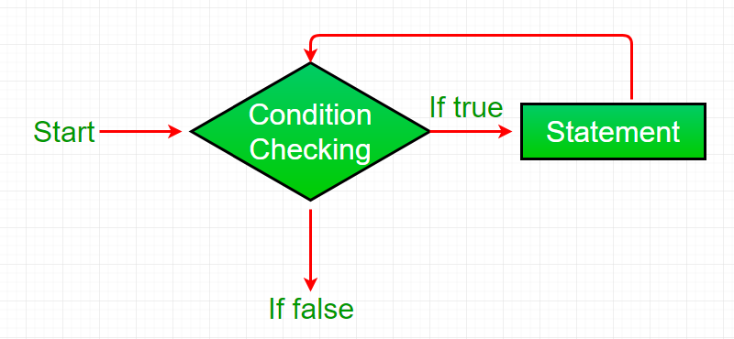

Slide 7
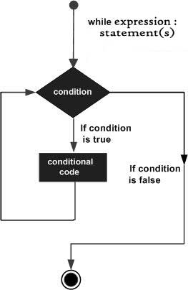
While Loop
A while loop statement in Python programming language repeatedly executes a target statement as long as a given condition is true

Slide 8
Example
count = 0
while (count < 9):
print (‘The count is:', count)
count = count + 1
print “bye!"

Slide 9
Infinite Loop
A loop becomes infinite loop if a condition never becomes FALSE.
You must use caution when using while loops because of the possibility that this condition never resolves to a FALSE value.
count = 1
while (count < 9):
print ('The count is:', count)
# count = count + 1
print “bye!"

Slide 10
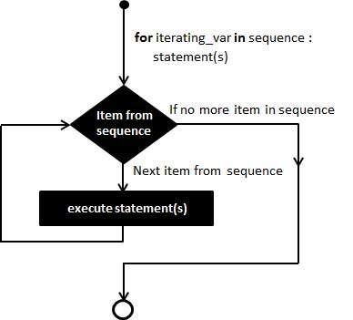
For Loop
For Loop is used to iterate through a Sequence like lists, tuples

Slide 11
Example
#exampl e1
for letter in 'Python':
print ('Current Letter :', letter)

Slide 12
Example 2
#example 2
fruits = ['banana', 'apple', 'mango']
for fruit in fruits:
print (Fruit Name:', letter)

Slide 13
Break Pass and Continue
Break statement Breaks the Loop
Pass statement is a placeholder when you don’t have any statements to write in the suite
Continue Breaks the current iteration and starts next iteration

Slide 14
Else Statement Loop
Python supports to have an else statement associated with a loop statement.
If the else statement is used with a for loop, the else statement is executed when the loop has exhausted iterating the list.
f the else statement is used with a while loop, the else statement is executed when the condition becomes false.

Slide 15
Else statement with For
count = 0
while count < 5:
print count, " is less than 5“
count = count + 1
else:
print count, " is not less than 5"

Slide 16
Else statement with For
numbers=[1,2,3,4,5]
else:
print count, " is not less than 5"

Slide 17
Nesting Loops
for iterating_var in sequence:
for iterating_var in sequence:
statements(s)
statements(s)
while expression:
while expression:
statements(s)
statements(s)

Slide 18
i = 2
while(i < 100):
j = 2
while(j <= (i/j)):
if not(i%j): break
j = j + 1
if (j > i/j) :
print (i, " is prime" )
i = i + 1

